Slide 1
Cracking the Facebook
Coding Interview
I <3 Facebook!
CareerCup

Slide 2
Why am I here?
00

Slide 3
Why would Facebook prep you?!?
Be more comfortable
Be more prepared
be YOUR best
Avoid common mistakes
Take out
the mystery

Slide 4






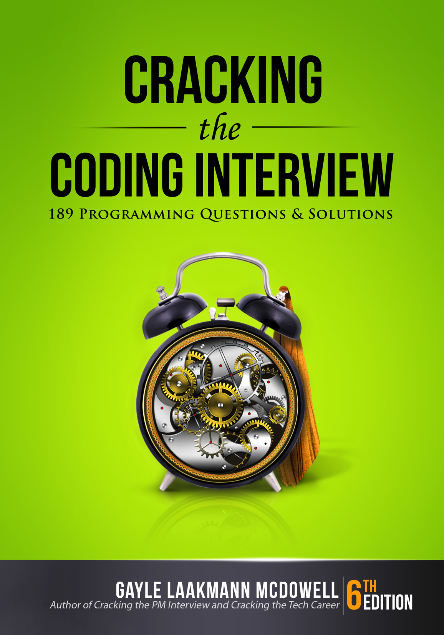
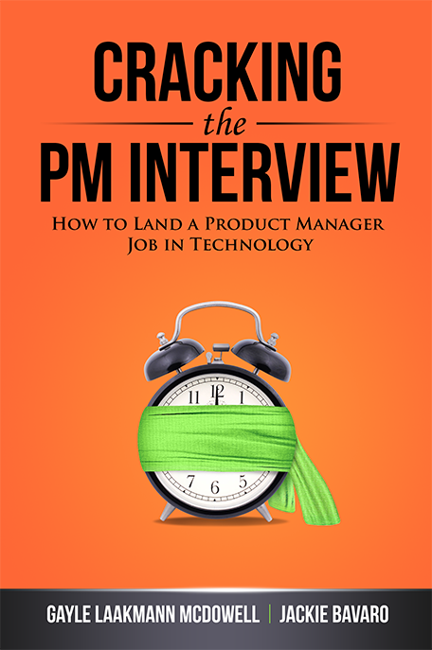



Hi! I’m Gayle Laakmann McDowell
(CS)
(MBA)
<dev>
</dev>
Author
Interview Coach
Interview Consulting

Slide 5


Yes! Slides are online!
Gayle.com
Click “Events”
Ctrl-F for “Facebook”
Email: g@gayle.com Subject: fbprep

Slide 6
Email: g@gayle.com Subject: fbprep
What to Expect

Slide 7
A Typical** Process (**not universal! Ask your recruiter)
Phone
Onsite
Hiring Committee & Decision
Algo / Coding
½ Behavioral
½ Algo / Coding
Design
Algo / Coding
Algo / Coding

Slide 8
5 Minutes
Prior Experience
45 Minutes
Question #1
Question #2
5 Minutes
Questions FOR Interviewer
Typical
Tech
Interview

Slide 9
Email: g@gayle.com Subject: fbprep
Behavioral Questions
02
The soft squishy stuff.

Slide 10
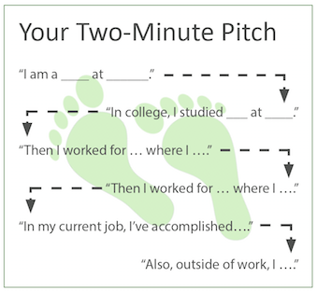
The Pitch / Resume Walk-Through
Shows of success
Prompt the interviewer
Hobbies

Slide 11
Your Past Work
2 – 3 Projects
Hard / cool
You were central
Technical depth
All Past Work
Challenges, architecture, tradeoffs, mistakes, successes, motivations
Teamwork, leadership, conflicts, etc
What did YOU do?
What would you do differently?

Slide 12
Be PASSIONATE
What
Be KNOWLEDGEABLE
about
YOU?
Be a GOOD TEAMMATE

Slide 13
Email: g@gayle.com Subject: fbprep
Design Questions
03
Big, meaty problems

Slide 14
W
W
Y
D
A
W
hat
ould
ou
o
t
ork
How
To
Approach

Slide 15
S
K
I
R
cope
ey components
dentify issues
epair
How
To
Approach

Slide 16
Scope the Problem
Ask questions
Make appropriate assumptions
Define Key Components
Can be somewhat naïve
Identify Issues
Bottlenecks, tradeoffs
Repair & Redesign
How
To
Approach
Discuss Top-> Down

Slide 17
How to Act
DRIVE
Lead the process
Be open about issues
TEAMWORK
Be open to feedback
Tweak as necessary
Use the whiteboard!

Slide 18
Read about design of major companies
THINK, don’t memorize!
Know key concepts
Tasks, sharding, caches.
Web stack, REST, etc
Practice back-of-the-envelope calculations
How
To
Prepare

Slide 19
Email: g@gayle.com Subject: fbprep
Algorithm Questions
04
Things that make you think

Slide 20
Why?
Analytical skills
How you think
Make tradeoffs
Push through hard problems
Communication
Strong CS fundamentals

Slide 21
Essential Knowledge
Data Structures | Algorithms | Concepts
ArrayLists | Merge Sort | Big O Time
Hash Tables | Quick Sort | Big O Space
Trees (+ Tries) & Graphs | Breadth-First Search | Recursion
Linked Lists | Depth-First Search | Memoization / Dynamic Programming
Stacks / Queues | Binary Search
Heaps

Slide 22
Preparation
MASTER Big O
Implement DS/Algorithms
Practice with interview questions
Code on paper/whiteboard
Mock interviews
PUSH YOURSELF!

Slide 23
Email: g@gayle.com Subject: fbprep
A Crash Course in Big O
Just getting your feet wet

Slide 24
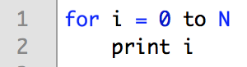
Basic for loop
Print 0 through N
Runtime?
O(N)

Slide 25
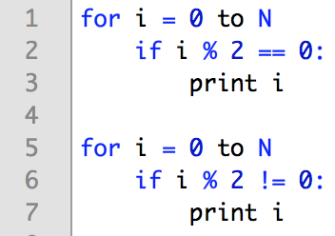
Two loops
Print evens, then odds
Runtime? O(N)

Slide 26
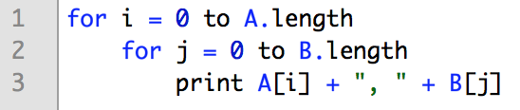
Basic for loop
Print pairs from two arrays
Runtime?
O(A * B)

Slide 27
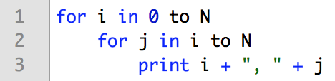
Basic for loop
Print ordered pairs
Runtime?
O(N²)
 | j : 0 → N
i : 0 → N | x | x | x | x | x | x
 |  | x | x | x | x | x
 |  |  | x | x | x | x
 |  |  |  | x | x | x
 |  |  |  |  | x | x
 |  |  |  |  |  | x

Slide 28
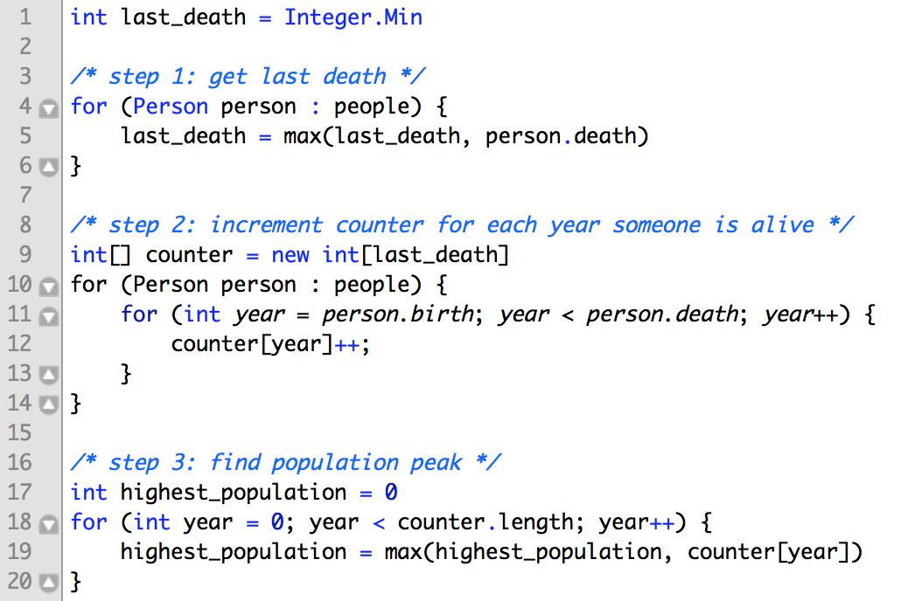
Okay now things are getting tougher!

Slide 29
Okay now things are getting tougher!
Step 1: O(P)
P = number of people
Step 2: O(P * Y)
Y = max life span
Step 3: O(L)
L = last death year
O(P + P * Y + L) → O(P * Y + L)

Slide 30
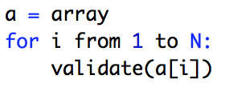
Almost there…
Print pairs from two arrays
Runtime?
undefine

Slide 31
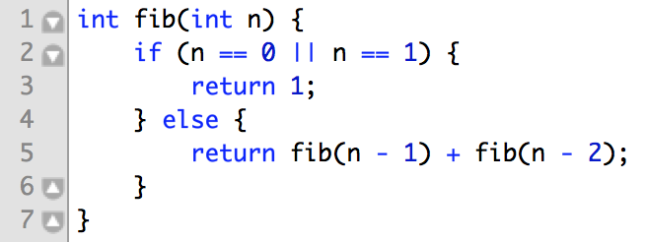
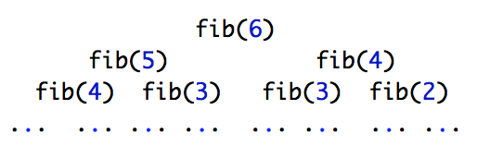
Eeek. Recursion?
Fibonacci
Runtime?
Height of N
Each level doubles # nodes
→ O(2^{N}) time ***
→ O(N) space
Actually slightly less for complex math reasons.

Slide 32
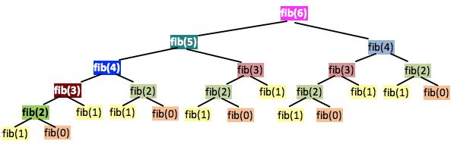
Eeek. Recursion?
Fibonacci

Slide 33
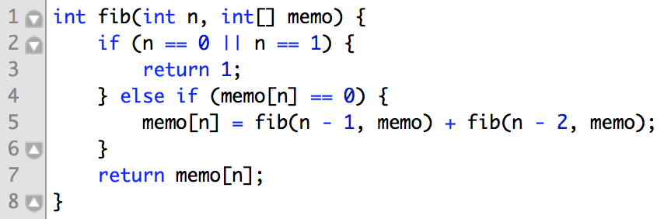
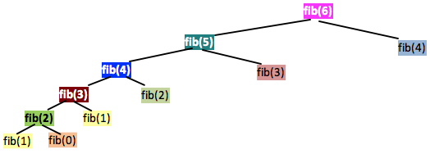
Eeek. Recursion?
Fibonacci, part 2
Runtime?
Height of N
Each level has <= 2 nodes
→ O(N) time
→ O(N) space

Slide 34
Reminders
Drop constants
Don’t drop non-constants
Different variables
Avoid ‘n’
Add vs. Multiply
Recursion call tree

Slide 35
Email: g@gayle.com Subject: fbprep
Solving Algorithms
How to… attempt to solve a hard problem

Slide 36
To know the answers
To solve immediately
To code perfectly
What
is NOT
(It’s nice. It just doesn’t happen*.)
expected
* Okay fine. It happened once, in 2000+ hiring packets.

Slide 37
Be excited about hard problems
Drive!
Keep trying when stuck
More than just “correct”
Pay attention to me!
Write real code
What
IS
expected
Show me how you think!

Slide 38
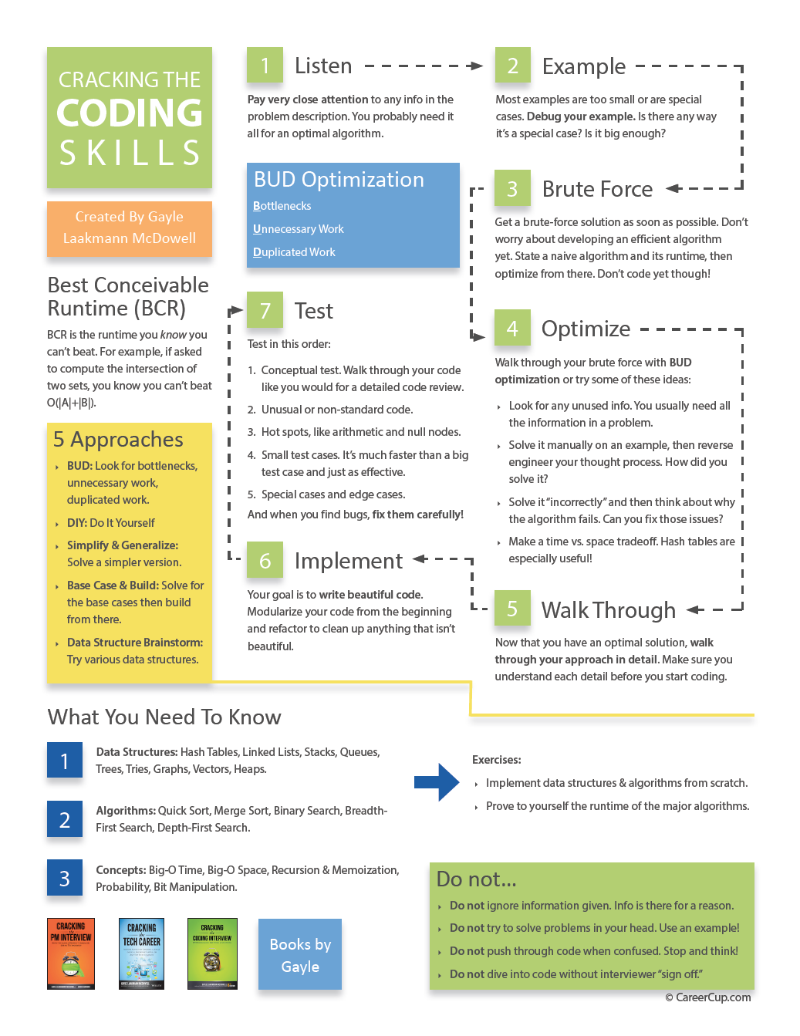
How
To
CrackingTheCodingInterview.com → “Resources”
Approach
Email: g@gayle.com Subject: fbprep

Slide 39

Listen (for clues)
step
1

Slide 40
What’s the clue?
Anagram server
Ex: rates -> aster, stare, taser, tears
Clue: why is it on a server?
Key (sorted string) | Value (list of words)
aerst | rates, aster, stare, taser, tears,
dgo | dog, god
acll | call
… | …

Slide 41
Draw an Example
Find # elements in common between two sorted, distinct arrays:
step
2

Slide 42
Ex: Intersection of Two Sorted Arrays
Most people draw something like this:
[1, 12, 15, 19]
[2, 12, 13, 20]
Too small
Too special-case-y
same size, one common element, same index

Slide 43
Ex: Intersection of Two Sorted Arrays
Better:
[1, 12, 15, 19, 20, 21]
[2, 15, 17, 19, 21, 25, 27]
Big
No special cases

Slide 44
Draw an Example
Big Enough
step
2
+
General Purpose

Slide 45
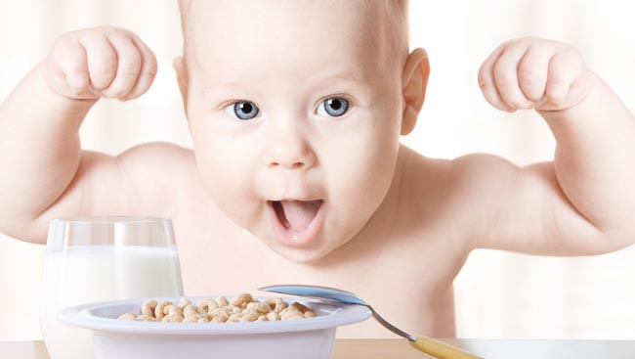
Brute Force / Naive
step
3
Stupid & terrible is okay!

Slide 46
Optimize
step
4
Walk through brute force
Look for optimizations

Slide 47
Techniques to Develop Algorithms
BUD
Space and Time
Do It Yourself
Recursion
Push yourself!

Slide 48
(A) Look for BUD
Bottlenecks
Unnecessary work
Duplicated work

Slide 49
What’s the bottleneck?
Ex: counting the intersection
[1, 12, 15, 19, 20, 21]
[2, 15, 17, 19, 21, 25, 27]
Bottleneck: searching
B

Slide 50
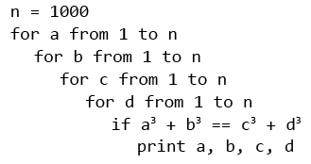
What’s unnecessary?
Ex: a³ + b³ = c³ + d³ (1 <= a, b, c, d <= 1000
Unnecessary: looking for d
U

Slide 51
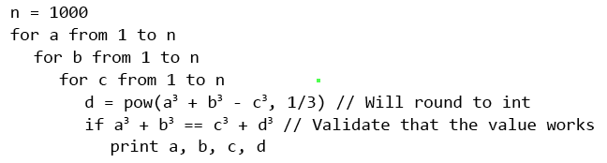
What’s unnecessary?
Ex: a³ + b³ = c³ + d³ (1 <= a, b, c, d <= 1000
Unnecessary: looking for d
U

Slide 52
What’s duplicated?
Ex: a³ + b³ = c³ + d³ (1 <= a, b, c, d <= 1000
Duplicated: c, d pairs
D

Slide 53
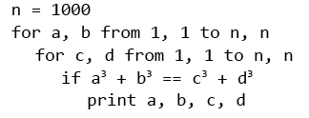
What’s duplicated?
Ex: a³ + b³ = c³ + d³ (1 <= a, b, c, d <= 1000
Duplicated: c, d pairs
c | d | c³ + d³
… | … | …
4 | 31 | 29855
4 | 32 | 32832
4 | 33 | 36001
… | … | …
5 | 59 | 205504
5 | 60 | 216125
5 | 61 | 227106
… | … | …
D

Slide 54
What’s duplicated?
Ex: a³ + b³ = c³ + d³ (1 <= a, b, c, d <= 1000
Duplicated: c, d pairs
c³ + d³ | (c, d)
… | …
29855 | (4, 31)
32832 | (4, 32), (18, 30)
36001 | (4, 33)
… | …
205504 | (5, 59)
216125 | (5, 60), (45, 50)
227106 | (5, 61)
… | …
D

Slide 55
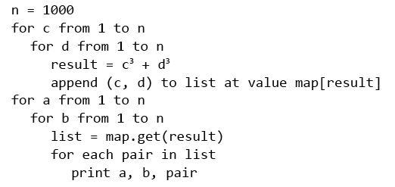
What’s duplicated?
Ex: a³ + b³ = c³ + d³ (1 <= a, b, c, d <= 1000
D

Slide 56
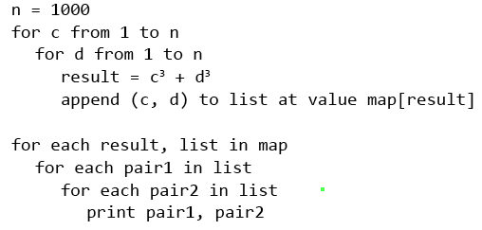
What’s duplicated?
Ex: a³ + b³ = c³ + d³ (1 <= a, b, c, d <= 1000
D

Slide 57
(B) Space/Time Tradeoffs
Hash tables & other data structures
Precomputing

Slide 58
Space/Time Tradeoffs → Precomputing
Find rectangle at origin w biggest sum
6 5 -9 2
-2 -5 -2 7 3 -2 10 13
-8 -3 1 -2
Brute force: compute all rectangles and sums

Slide 59
Space/Time Tradeoffs → Precomputing
Find rectangle at origin w biggest sum
6 5 -9 2
-2 -5 -2 7 3 -2 10 13
-8 -3 1 -2

Slide 60
Space/Time Tradeoffs → Precomputing
Find rectangle with biggest sum
6 5 -9 2
-2 -5 -2 7 3 -2 10 13
-8 -3 1 -2
=
+
-
+ 10

Slide 61
Space/Time Tradeoffs → Precomputing
Find rectangle with biggest sum
6 5 -9 2
-2 -5 -2 7 3 -2 10 13
-8 -3 1 -2
=
+
-
+ 13

Slide 62
(C) Do it yourself
Find permutations of s within b

Slide 63
find abbc in
babcabbacaabcbabcacbb

Slide 64
(C) Do it yourself
Find permutations of s within b
s = abbc
b = babcabbacaabcbabcacbb
Find them!
… now how did you actually do it?

Slide 65
(D) Recursion
Use, but don’t cling to, recursion “instinct”
Try bottom-up
“Backtracking”
Draw call-tree
Derive runtime
Find repeated subproblems
Subsets of a set
{} → {}
{a} → {}, {a}
{a, b} → {}, {a}, {b}, {a, b}
{a, b, c} → …
Subsets of {S₁…S_{n-1}} + S_{n} to each

Slide 66
Techniques to Develop Algorithms
BUD
Space and Time
Do It Yourself
Recursion
Push yourself!

Slide 67

Walk Through
step
5
Know the variables
and when they change

Slide 68
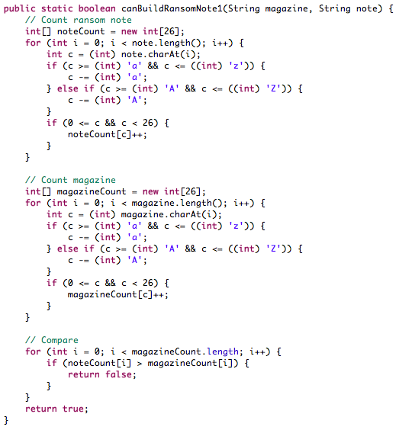
Write Beautiful Code
step
6

Slide 69
How to Write Whiteboard Code
Write straight
Top-left corner
Use arrows if needed
Error cases
Good style
Modularize (upfront!)
Language choice is up to you!

Slide 70
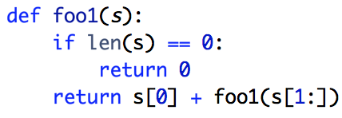
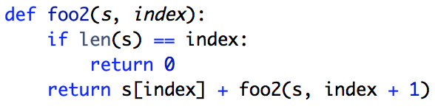
Language Choice
Java, Objective C, etc: Abbreviate
Python, Ruby, JS, etc: Careful with built-in functions

Slide 71
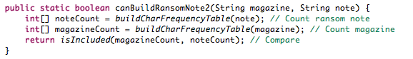
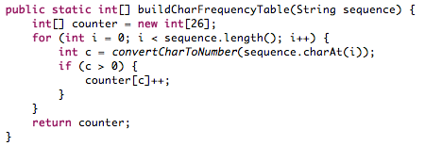
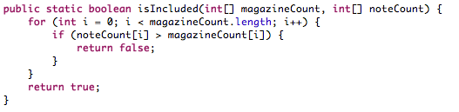
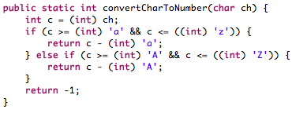
Modularization

Slide 72
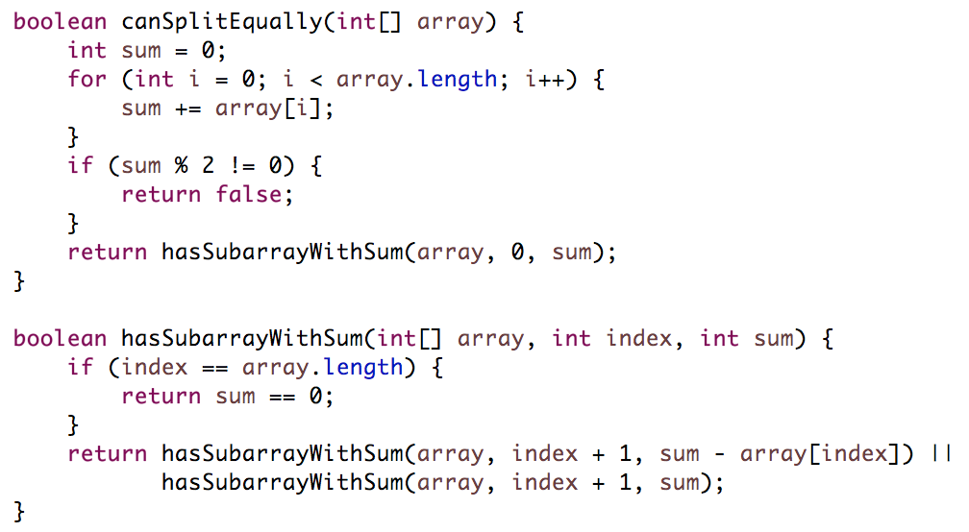
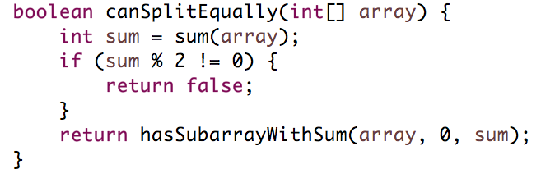
Modularize (Upfront!)
I’ve learned nothing.

Slide 73
Testing
Find permutations of s within b:
s = abbc
b = babcabbacaabcbabcacbb
for (i=0; i < b.len–s.len; i++) {
if (isPerm(s, b.subs(i, s.len)) …
}
FIRST Analyze
What’s it doing? Why?
Anything that looks weird?
Error hot spots
THEN use test cases
Small test cases
Edge cases
Bigger test cases
BUT…
Test code, not algorithm
Think as you test
Think before you fix
step
7

Slide 74
How
To
CrackingTheCodingInterview.com → “Resources”
Approach
Email: g@gayle.com Subject: fbprep

Slide 75
Email: g@gayle.com Subject: fbprep
Questions for Your Interviewer
05
What do you want to know?

Slide 76
Prepare some questions
What’s made you happy / unhappy?
What are your goals?
Culture & work style
Career paths
Technology

Slide 77
Email: g@gayle.com Subject: fbprep
Final Thoughts
06
And questions

Slide 78
Be a great teammate.
It’s done
for a
reason!
Be a great engineer.

Slide 79
But wait, there’s one more thing...
Email: g@gayle.com Subject: fbprep
READY? Follow up with your recruiter to schedule your next steps.
JOB POSTINGS: facebook.com/careers/teams/engineering
SLIDES? Gayle.com -> Events -> search “Facebook”

Slide 80
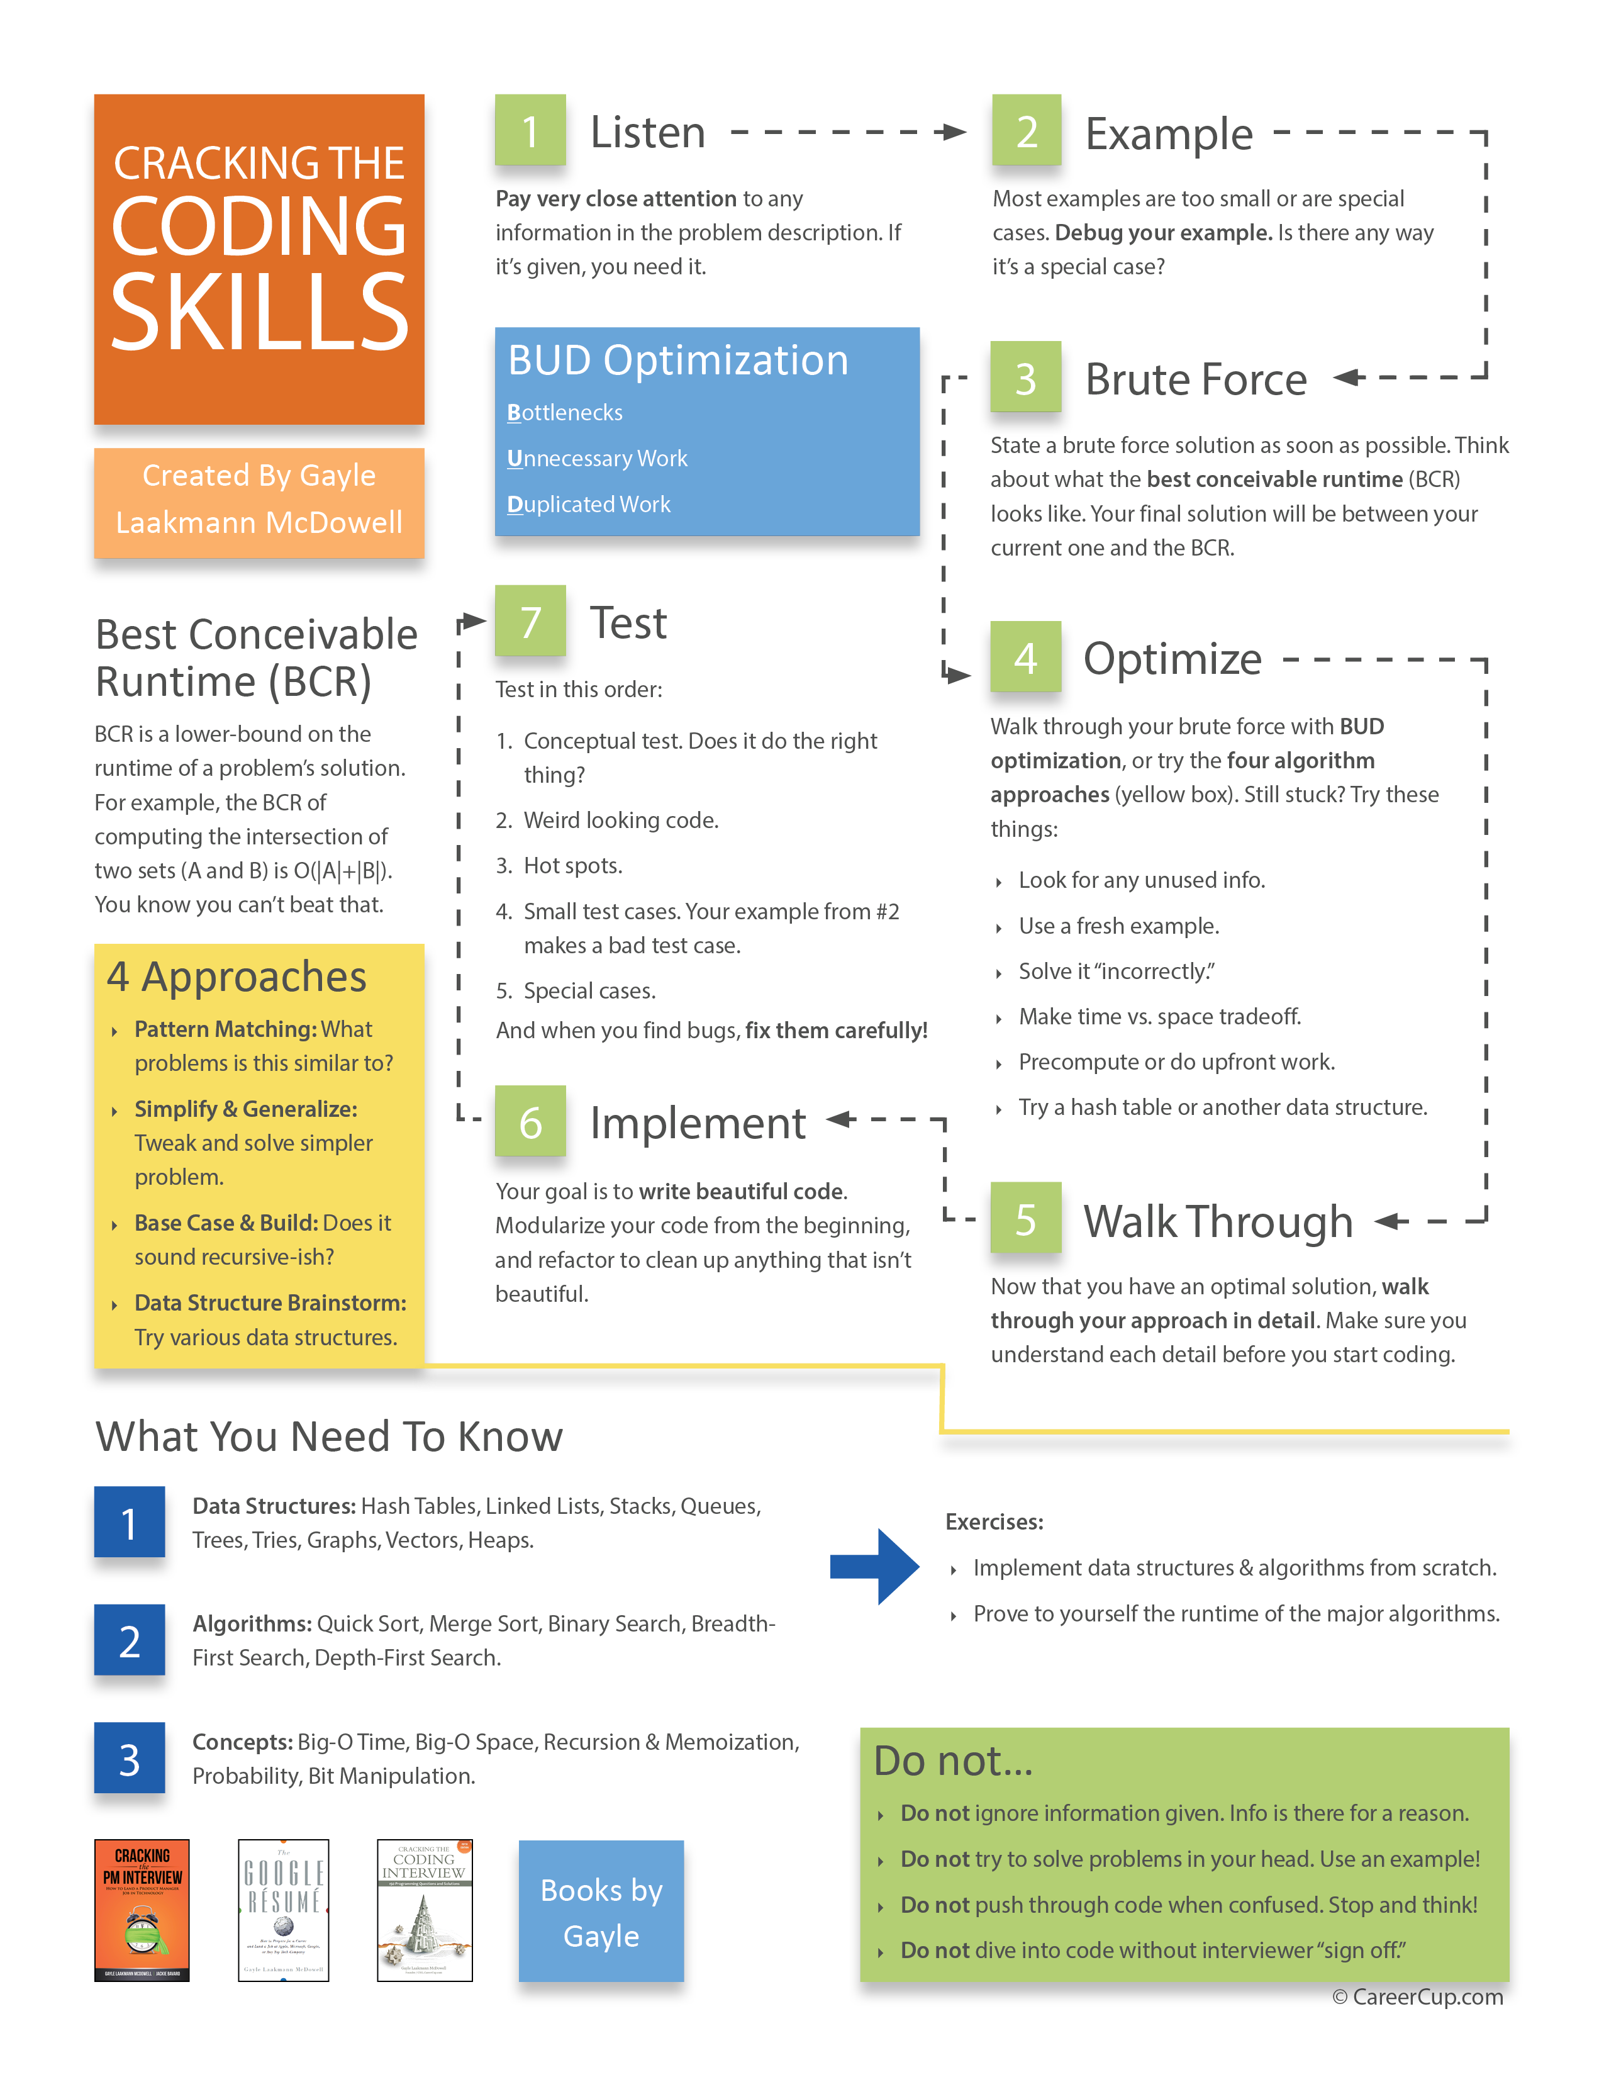

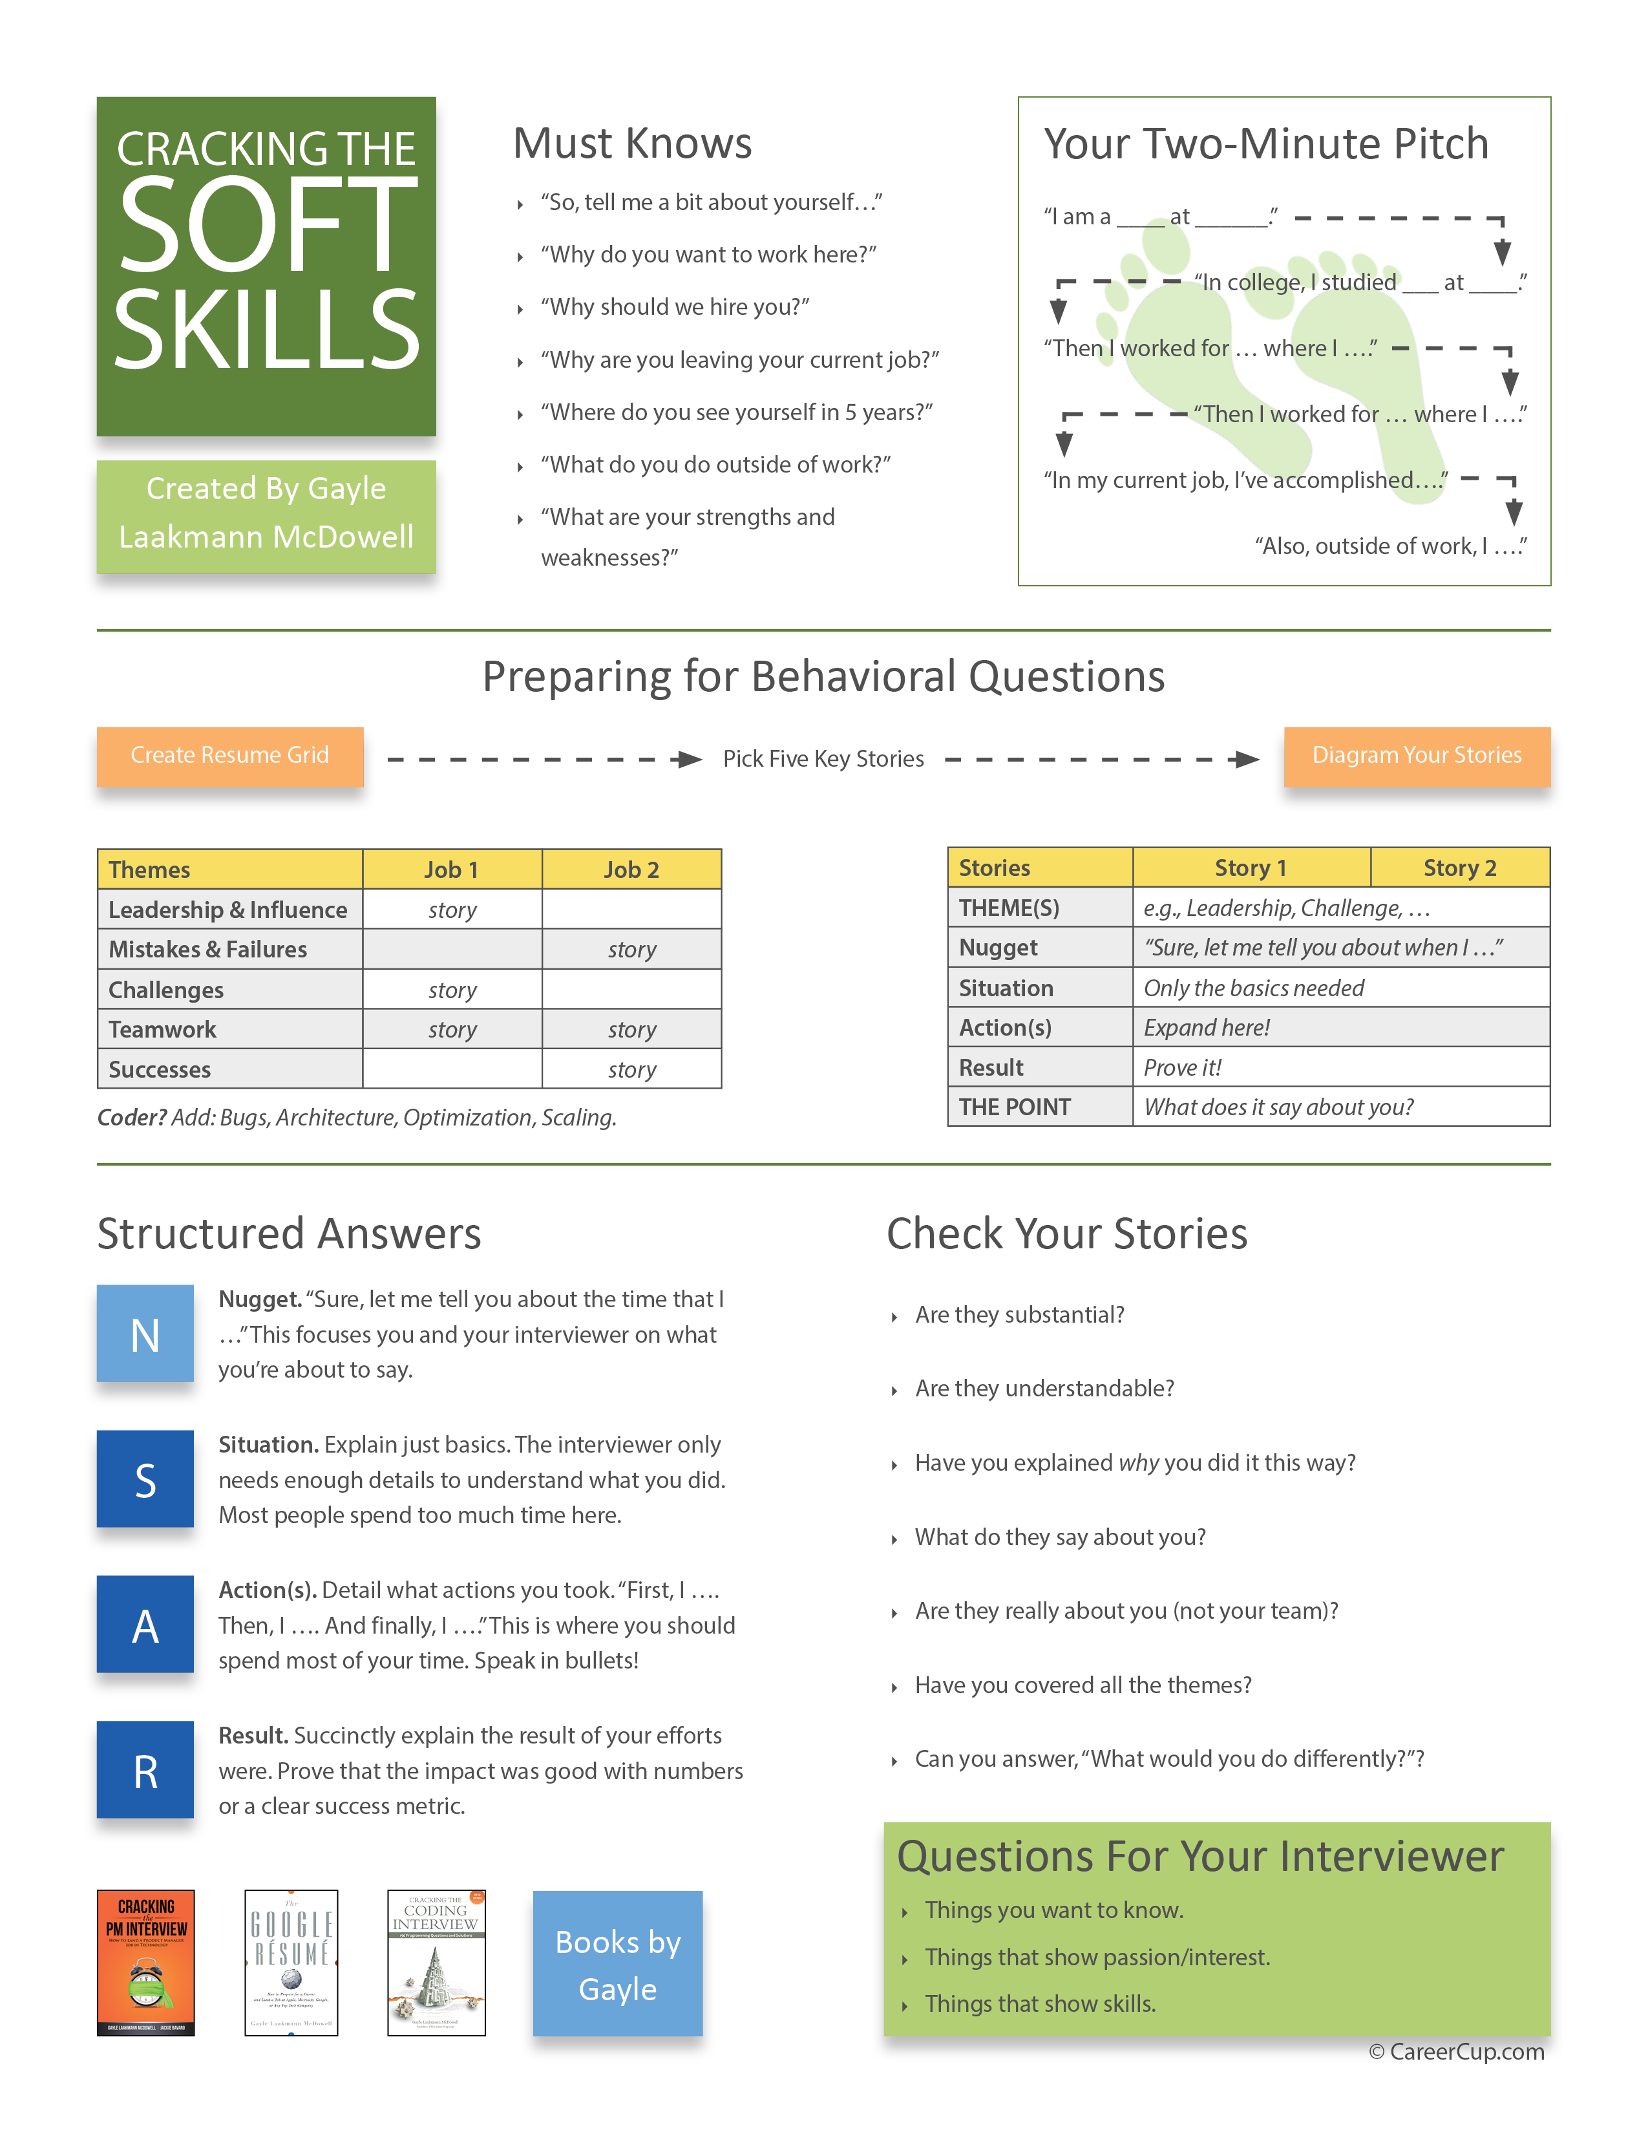
Other Resources
Gayle.com CareerCup.com
CrackingThe CodingInterview.com
Or, follow me online
facebook.com/gayle
twitter.com/gayle
gayle.com
gayle@gayle.com
quora.com
Email: g@gayle.com Subject: fbprep

